Slide 1
Weeks 3-4 Progress
Audrey Robison
Advisor: Dr. Jiong Qiu
MSU REU Summer 2022

Slide 2
Goal of this Summer Project
The goal of this project is to determine the properties of reconnection in solar flares including:
Reconnection Rate
Reconnection Shear

Slide 3
Goal 1: Reconnection Rate
Measurement of reconnection rate
Justification of the bounds of the defined flare pixels

Slide 4
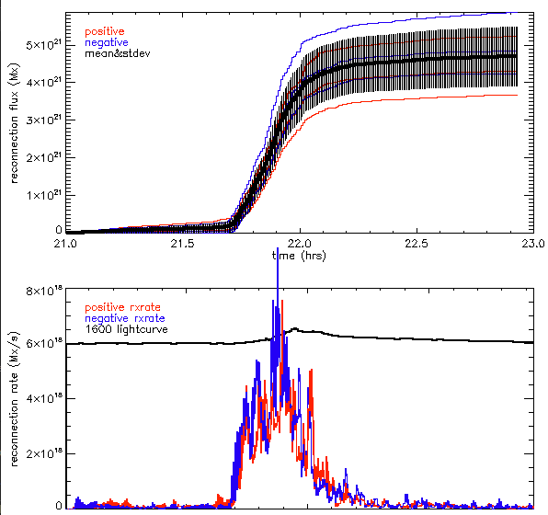
Graph of reconnection flux and reconnection rate
Notes:
Blue: negative red: positive. The lines indicate the amount of flux in each flare pixel over time. The negative is represented by blue and the positive by red. The first graph indicates the flux over time and the second indicates the change in flux over time or the reconnection rate. I generated these graphs in the first week, achieving the first goal of this summer research program, measuring the rate of reconnection.

Slide 5
Reconnection Shear
How angle changes over time of flare ribbons: higher shear at first then lower shear
Guide field is stronger at first then weaker over time
Angle approaches 90 degrees over time
Notes:
The second objective of this study is to measure the reconnection shear. The guide field, the component of the electromagnetic field that is not involved in magnetic reconnection, causes the filed lines to shear. I am trying to map this shear over time, by representing how the magnitude of the shear increases or decreases over time as the flare evolves. The angle at which the loops form at first is a sheared small angle, and over time the exterior loops become closer to right, 90 degrees angles.

Slide 6
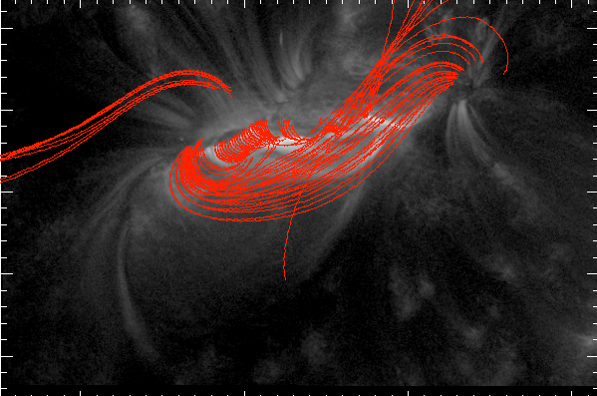
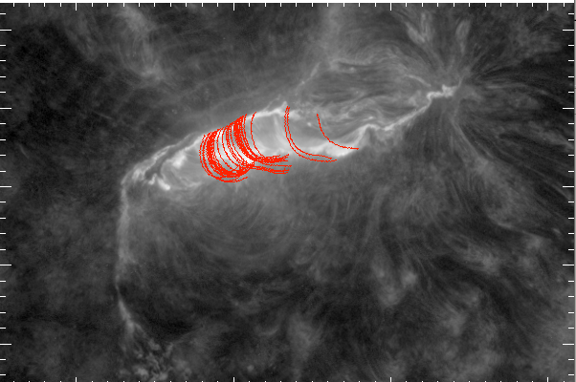
Wavelength: 131
Phase 1: high shear
Wavelength: 304
Phase 5: slow expansion b
(less shear)

Slide 7
Next Steps
Finding a method to verify our observations quantitatively

